Slide 1
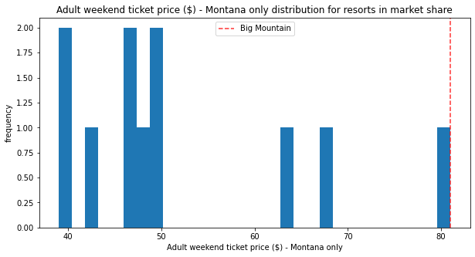
Ticket Price at Big Mountain Resort
Big Mountain is charging a very modest price in tandem with what they offer when compared to the rest of the market

Slide 2
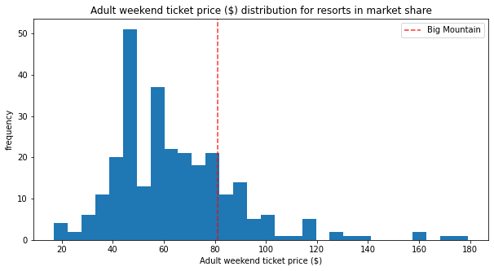
A New Ticket Price
Big Mountain’s modelled ticket price is $95.87
Big Mountain should immediately increase their Adult Weekend Ticket Price from $81 to $85

Slide 3
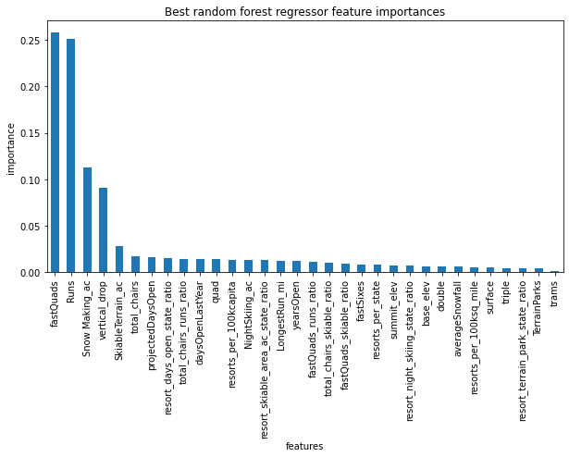
What is important in a Ski Resort?
This random forest regression model shows which features have the biggest effect on the Adult Weekend Ticket Price

Slide 4
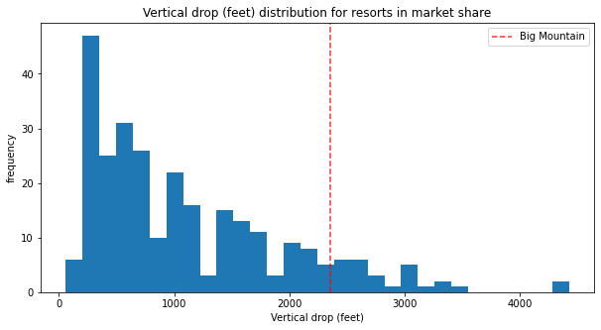
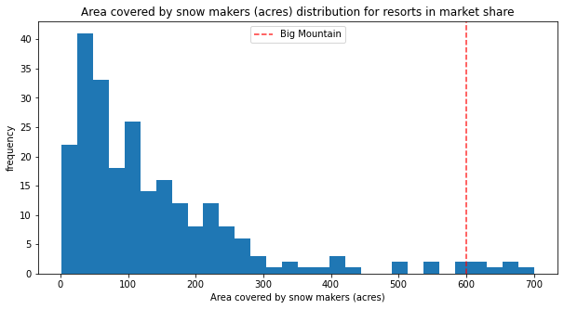
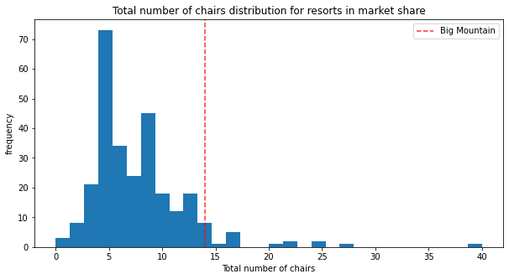
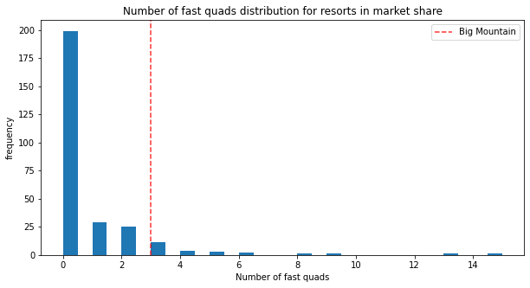
How much does Big Mountain offer?

Slide 5
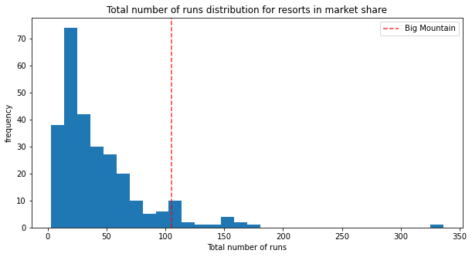
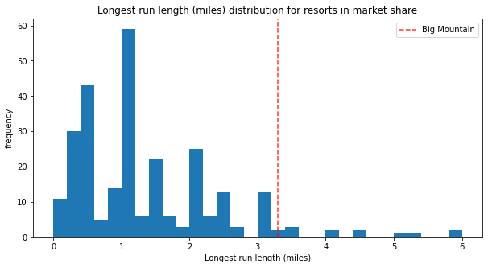
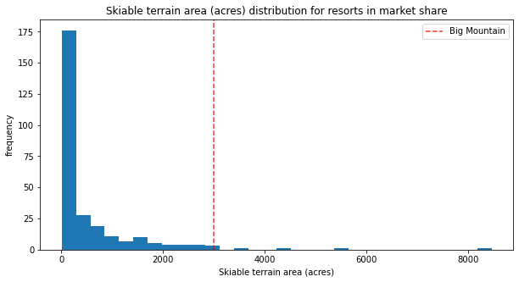
How big is Big Mountain?

Slide 6
In Conclusion
Compared to other resorts in this country, Big Mountain is among the best
Big Mountain can afford to charge a higher ticket price without worrying about losing business
Big Mountain should keep an eye on how that affects business while considering another ticket price increase in the future

